Slide 1
FP 2 – DPU Presentation
Johnathan L. & Joe T.

Slide 2
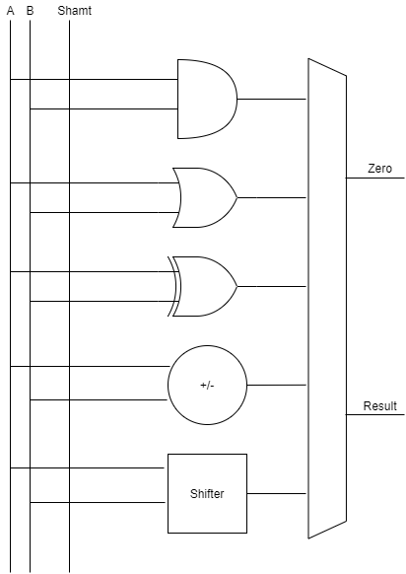
ALU Design
Simple, very few instructions
If it’s easy to understand, it won’t be too difficult to implement
Operations: AND, OR, XOR, addition, subtraction, shifts

Slide 3
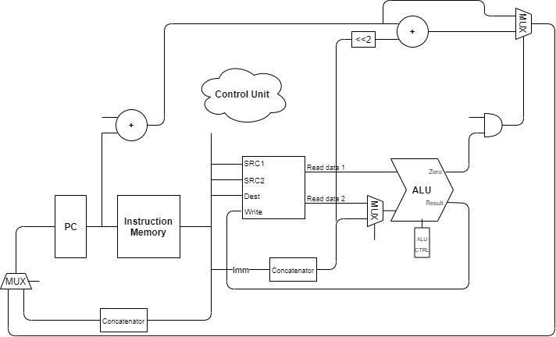
DPU Design
Harvard architecture (sort of)
Single-cycle
64 Registers

Slide 4
BEQ

Slide 5
JMP

Slide 6
ADI

Slide 7
How did it go?
Had to scrap most of our language design from fp1
Very similar to MIPS single-cycle
Interesting piece:
No data memory! (Theoretical design)

